Slide 1
Chapter 4: Protecting the Organization
Instructor Materials
Introduction to Cybersecurity v2.1
Notes:
Cisco Networking Academy Program
Introduction to Cybersecurity v2.1
Chapter 4: Protecting the Organization

Slide 2
Instructor Materials – Chapter 4 Planning Guide
This PowerPoint deck is divided in two parts:
Instructor Planning Guide
Information to help you become familiar with the chapter
Teaching aids
Instructor Class Presentation
Optional slides that you can use in the classroom
Begins on slide # 10
Note: Remove the Planning Guide from this presentation before sharing with anyone.
Notes:
2

Slide 3
Chapter 4: Protecting the Organization
Introduction to Cybersecurity v2.1 Planning Guide
Notes:
Cisco Networking Academy Program
Introduction to Cybersecurity v2.1
Chapter 4: Protecting the Organization

Slide 4
Chapter 4: Activities
What activities are associated with this chapter?
Page # | Activity Type | Activity Name
4.1.1.2 | Interactive Activity | Identify the Firewall Type
4.1.1.4 | Interactive Activity | Identify the Port Scan Response
4.1.2.2 | Interactive Activity | Identify the Security Appliance
4.2.2.2 | Interactive Activity | Order the Stages of the Kill Chain
4.3.4.2 | Interactive Activity | Identify Cybersecurity Approach Terminology
Notes:
4

Slide 5
Chapter 4: Assessment
Students should complete Chapter 4, “Assessment” after completing Chapter 4.
Quizzes and other activities can be used to informally assess student progress.
Notes:
5

Slide 6
Chapter 4: Best Practices
Prior to teaching Chapter 4, the instructor should:
Complete Chapter 4, “Assessment.”
Review the Additional Resources and Activities document in the Student Resources for possible additional resources and activities.
The objectives of this chapter are:
Describe the various types of firewalls.
Describe different types of security appliances.
Describe different methods of detecting attacks in real time.
Describe methods of detecting malware.
Describe security best practices for organizations.
Define the term botnet.
Define the term kill chain.
Notes:
6

Slide 7
Chapter 4: Best Practices (Cont.)
The objectives of this chapter are: (Cont.)
Define behavior-based security.
Explain how NetFlow helps to defend against cyberattacks.
Identify the function of CSIRT within Cisco.
Explain the purpose of a security playbook.
Identify tools used for incident prevention and detection.
Define IDS and IPS.
Notes:
7

Slide 8
Chapter 4: Additional Help
For additional help with teaching strategies, including lesson plans, analogies for difficult concepts, and discussion topics, visit the Community Forums .
If you have lesson plans or resources that you would like to share, upload them to the Community Forums in order to help other instructors.
Notes:
8

Slide 10
Chapter 4: Protecting the Organization
Introduction to Cybersecurity v2.1
Notes:
Cisco Networking Academy Program
Introduction to Cybersecurity v2.1
Chapter 4: Protecting the Organization

Slide 11
Chapter 4 - Sections & Objectives
4.1 Firewalls
Explain techniques to protect organizations from cyber attacks.
Describe the various types of firewalls.
Describe different types of security appliances.
Describe different methods of detecting attacks in real time.
Describe methods of detecting malware.
Describe security best practices for organizations.
4.2 Behavior Approach to Cybersecurity
Explain the behavior-based approach to cybersecurity.
Define the term botnet.
Define the term kill chain.
Define behavior-based security.
Explain how NetFlow helps to defend against cyberattacks.
Notes:
11
Cisco Networking Academy Program
Introduction to Cybersecurity v2.1
Chapter 4: Protecting the Organization

Slide 12
Chapter 4 - Sections & Objectives (Cont.)
4.3 Cisco’s Approach to Cybersecurity
Explain the Cisco approach to providing cybersecurity.
Identify the function of CSIRT within Cisco.
Explain the purpose of a security playbook.
Identify tools used for incident prevention and detection.
Define IDS and IPS.
Notes:
12
Cisco Networking Academy Program
Introduction to Cybersecurity v2.1
Chapter 4: Protecting the Organization

Slide 13
4.1 Firewalls
Notes:
4 – Protecting the Organization
4.1 – Firewalls

Slide 14
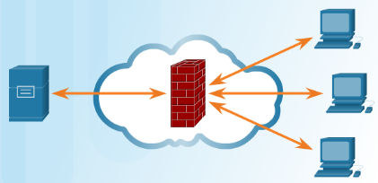
Firewalls Types Firewall Types
Control or filter incoming or outgoing communications on a network or device
Common firewall types
Network Layer Firewall – source and destination IP addresses
Transport Layer Firewall – source and destination data ports, connection states
Application Layer Firewall – application, program or service
Context Aware Application Firewall – user, device, role, application type, and threat profile
Proxy Server –web content requests
Reverse Proxy Server – protect, hide, offload, and distribute access to web servers
Network Address Translation (NAT) Firewall – hides or masquerades the private addresses of network hosts
Host-based Firewall – filtering of ports and system service calls on a single computer operating system
Notes:
4.1 – Firewalls
4.1.1 – Firewall Types
4.1.1.1 – Firewall Types

Slide 15
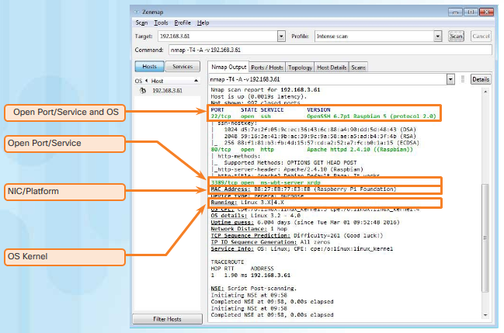
Firewall Types Port Scanning
Process of probing a computer, server or other network host for open ports
Port numbers are assigned to each running application on a device.
Reconnaissance tool to identify running OS and services
Nmap – A port scanning tool
Common responses:
Open or Accepted - a service is listening on the port.
Closed, Denied, or Not Listening – connections will be denied to the port.
Filtered, Dropped, or Blocked – no reply from the host.
Notes:
4.1 – Firewalls
4.1.1 – Firewall Types
4.1.1.3 – Port Scanning

Slide 16
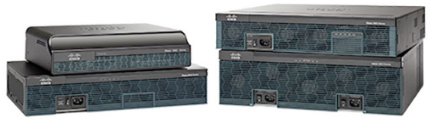
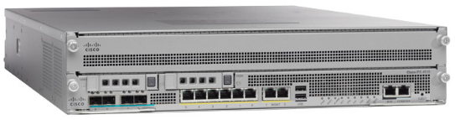

Security Appliances Security Appliances
Security appliances fall into these general categories:
Routers - can have many firewall capabilities: traffic filtering, IPS, encryption, and VPN.
Firewalls – may also have router capability, advanced network management and analytics.
IPS - dedicated to intrusion prevention.
VPN - designed for secure encrypted tunneling.
Malware/Antivirus - Cisco Advanced Malware Protection (AMP) comes in next generation Cisco routers, firewalls, IPS devices, Web and Email Security Appliances and can also be installed as software in host computers.
Other Security Devices – includes web and email security appliances, decryption devices, client access control servers, and security management systems.
Notes:
4.1 – Firewalls
4.1.2 – Security Appliances
4.1.2.1 – Security Appliances

Slide 17
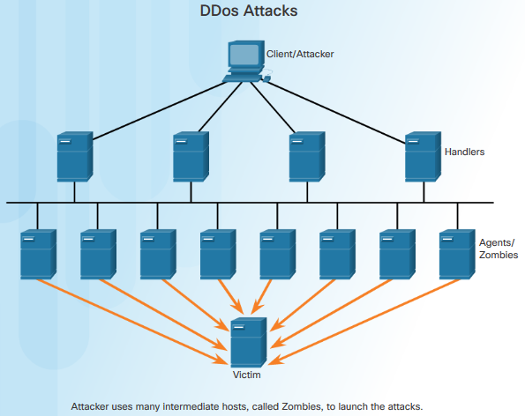
Detecting Attacks in Real Time Detecting Attacks in Real Time
Zero-day attack
A hacker exploits a flaw in a piece of software before the creator can fix it.
Real Time Scanning from Edge to Endpoint
Actively scanning for attacks using firewall and IDS/IPS network device
detection with connections to online global threat centers
detect network anomalies using context-based analysis and behavior detection
DDoS Attacks and Real Time Response
DDoS, one of the biggest attack threats, can cripple Internet servers and network availability.
DDoS originates from hundreds, or thousands of zombie hosts, and the attacks appear as legitimate traffic.
Notes:
4.1 – Firewalls
4.1.3 – Detecting Attacks in Real Time
4.1.3.1 – Detecting Attacks in Real Time

Slide 18
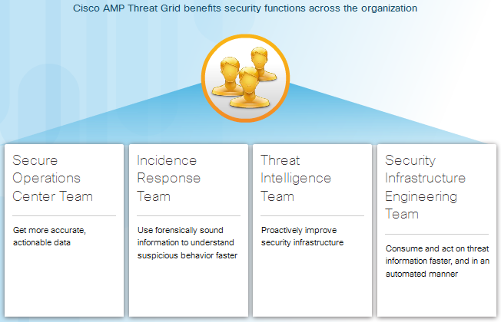
Detecting Malware Protecting Against Malware
Notes:
4.1 – Firewalls
4.1.4 – Detecting Malware
4.1.4.1 – Protecting Against Malware

Slide 19
Security Best Practices Security Best Practices
Some published Security Best Practices:
Perform Risk Assessment – Knowing the value of what you are protecting will help in justifying security expenditures.
Create a Security Policy – Create a policy that clearly outlines company rules, job duties, and expectations.
Physical Security Measures – Restrict access to networking closets, server locations, as well as fire suppression.
Human Resource Security Measures – Employees should be properly researched with background checks.
Perform and Test Backups – Perform regular backups and test data recovery from backups.
Maintain Security Patches and Updates – Regularly update server, client, and network device operating systems and programs.
Employ Access Controls – Configure user roles and privilege levels as well as strong user authentication.
Regularly Test Incident Response – Employ an incident response team and test emergency response scenarios.
Implement a Network Monitoring, Analytics and Management Tool - Choose a security monitoring solution that integrates with other technologies.
Implement Network Security Devices – Use next generation routers, firewalls, and other security appliances.
Implement a Comprehensive Endpoint Security Solution – Use enterprise level antimalware and antivirus software.
Educate Users – Educate users and employees in secure procedures.
Encrypt data – Encrypt all sensitive company data including email.
Notes:
4.1 – Firewalls
4.1.5 – Security Best Practices
4.1.5.1 – Security Best Practices

Slide 20
4.2 Behavior Approach to Cybersecurity
Notes:
4 – Protecting the Organization
4.2 – Behavior Approach to Cybersecurity

Slide 21
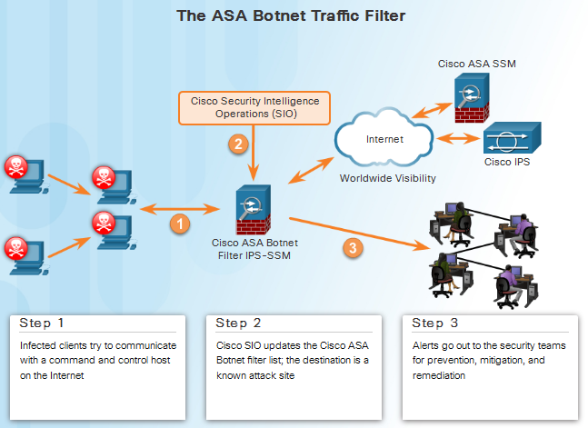
Botnet Botnet
Botnet
A group of bots connect through the Internet
Controlled by malicious individuals or groups
Bot
Typically infected by visiting a website, opening an email attachment, or opening an infected media file
Notes:
4.2 – Behavior Approach to Cybersecurity
4.2.1 - Botnet
4.2.1.1 - Botnet

Slide 22
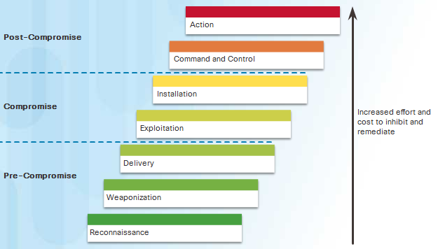
Kill Chain The Kill Chain in Cyberdefense
Kill Chain is the stages of an information systems attack.
1. Reconnaissance – Gathers information
2. Weaponization - Creates targeted exploit and malicious payload
3. Delivery - Sends the exploit and malicious payload to the target
4. Exploitation – Executes the exploit
5. Installation - Installs malware and backdoors
6. Command and Control - Remote control from a command and control channel or server.
7. Action – Performs malicious actions or additional attacks on other devices
Notes:
4.2 – Behavior Approach to Cybersecurity
4.2.2 – Kill Chain
4.2.2.1 – The Kill Chain in Cyberdefense

Slide 23
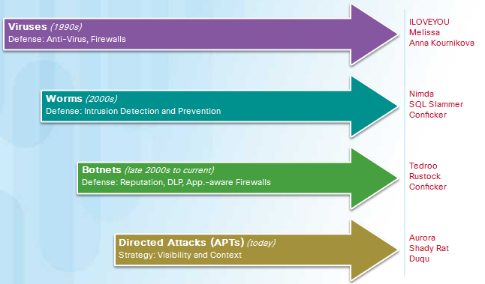
Behavior-Based Security Behavior-Based Security
Honeypots
Lures the attacker by appealing to the attackers’ predictable behavior
Captures, logs and analyze the attackers’ behavior
Administrator can gain more knowledge and build better defense
Cisco’s Cyber Threat Defense Solution Architecture
Uses behavior-based detection and indicators
Provide greater visibility, context and control
Notes:
4.2 – Behavior Approach to Cybersecurity
4.2.3 – Behavior-Based Security
4.2.3.1 – Behavior-Based Security

Slide 24
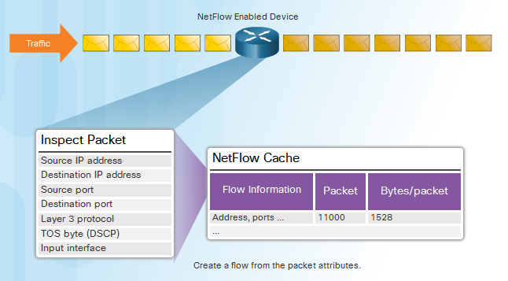
NetFlow and Cyberattacks Netflow
Gather information about data flowing through a network
Important components in behavior-based detection and analysis
Establish baseline behaviors
Notes:
4.2 – Behavior Approach to Cybersecurity
4.2.4 – NetFlow and Cyberattacks
4.2.4.1 – NetFlow

Slide 25
4.3 Cisco’s Approach to Cybersecurity
Notes:
4 – Protecting the Organization
4.3 – Cisco’s Approach to Cybersecurity

Slide 26


CSIRT CSIRT
Computer Security Incident Response Team
help ensure company, system, and data preservation by performing comprehensive investigations into computer security incidents
provides proactive threat assessment, mitigation planning, incident trend analysis, and security architecture review
Notes:
4.3 – Cisco’s Approach to Cybersecurity
4.3.1 – CSIRT
4.3.1.1 - CSIRT

Slide 27

Security Playbook Security Playbook
Collection of repeatable queries against security event data sources that lead to incident detection and response
What does it need to accomplish?
Detect malware infected machines.
Detect suspicious network activity.
Detect irregular authentication attempts.
Describe and understand inbound and outbound traffic.
Provide summary information including trends, statistics, and counts.
Provide usable and quick access to statistics and metrics.
Correlate events across all relevant data sources.
Notes:
4.3 – Cisco’s Approach to Cybersecurity
4.3.2 – Security Playbook
4.3.2.1 - Security Playbook

Slide 28

Tools for Incident Prevention and Detection Tools for Incident Prevention and Detection
SIEM – Security Information and Event Management
Software that collects and analyzes security alerts, logs and other real time and historical data from security devices on the network
DLP – Data Loss Prevention
Stops sensitive data from being stolen or escaped from the network
Designs to monitor and protect data in three different states
Cisco Identity Services Engine (Cisco ISE) and TrustSec
Uses role-based access control policies
Notes:
4.3 – Cisco’s Approach to Cybersecurity
4.3.3 – Tools for Incident Prevention and Detection
4.3.3.1 - Tools for Incident Prevention and Detection

Slide 29
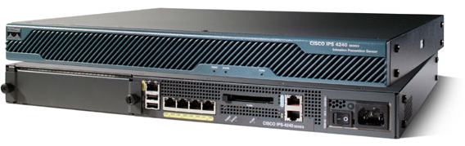
IDS and IPS IDS and IPS
IDS – Intrusion Detection System
Usually placed offline
Does not prevent attacks
Detect, log, and report
IPS – Intrusion Prevention System
Ability to block or deny traffic based on a positive rule or signature match
IDS/IPS system
Snort
Sourcefire (Cisco)
Notes:
4.3 – Cisco’s Approach to Cybersecurity
4.3.4 – IDS and IPS
4.3.4.1 - IDS and IPS

Slide 30
4.4 Chapter Summary
Notes:
4 – Protecting the Organization
4.4.1.1 – Summary

Slide 31
Summary Chapter Summary
Describe the various types of firewalls and security appliances.
Describe different methods of detecting malware and attacks in real time.
Describe security best practices for organizations.
Define botnet, kill chain, and behavior-based security.
Explain how Netflow can help defend against cyberattacks.
Identify the function of CSIRT within Cisco.
Explain the purpose of a security playbook.
Identify tools used for incident prevention and detection.
Define IDS and IPS.
Notes:
4.4 - Summary
4.4.1 – Summary
4.4.1.1 – Chapter Summary

